Slide 1
Database Project
Our contester database.

Slide 2

Contents
Here’s what you’ll find in this presentation:
A short introduction to our team and project.
Requirements for this project.
Project execution
Research and idea consolidation
More improvement and optimization

Slide 3

Introduction
Introduction to our team and project.

Slide 4

Our Team
Alda Kata
Detjon Mataj
Drin Karkini

Slide 5
Our Team (cont.)
Melisa Alliu
Sara Martiri
Terens Tare

Slide 6
Contester++
Contester++ is a platform designed for academic use where teachers, students, and other people can compete in contests, create and solve programming problems in a competitive manner. These problems may vary from easy to olympic difficulty.

Slide 7
Our Moto
“Supporting Tomorrow’s Problems Solvers Today”

Slide 8
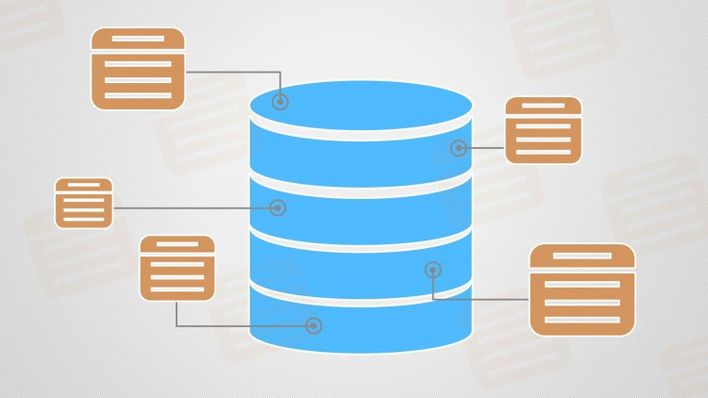
Requirements
A collection of the requirements needed for our database.

Slide 9
Requirements
Users
Each user will have it’s personal information. They will also have information about the department they are part of, the settings they have chosen for their account, their roles, and their rank based on the amount of questions solved.
Comments
Students and teachers can give their comments on questions and discuss potential difficulties.
Questions
Questions are the problems which the users can solve. They vary in volumes, categories and difficulty levels. They also contain test cases.
Contests
A variety of questions can be organized to form a contest in which groups of students can compete with each other.

Slide 10
Requirements (cont.)
Announcements
Contester can announce news to the users and the can belong to different categories.
User settings
User settings as the settings a user chooses for their preferred programming language, theme and language.
TODO-s
Users can a have a list of TODO-s and they may contain questions.
Favourite Questions
A collection of questions which the user saves as their favourite.
FAQ-s
This is a list of questions(not the entity) which are frequently asked by students.
Assignments
Teachers can combine questions to create assignments, which then they can assign to students or groups of students. Assignments can have files attached to them for clarification.

Slide 11
Project Execution
Conceptual data modeling with EERD.
Database creation.
Explaining our design details.
Information retrieval.

Slide 12
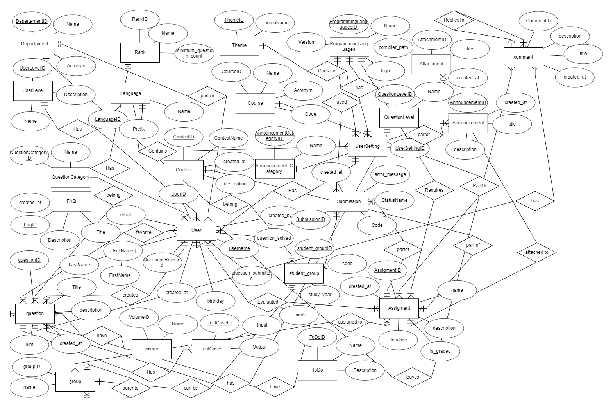
ERD

Slide 13
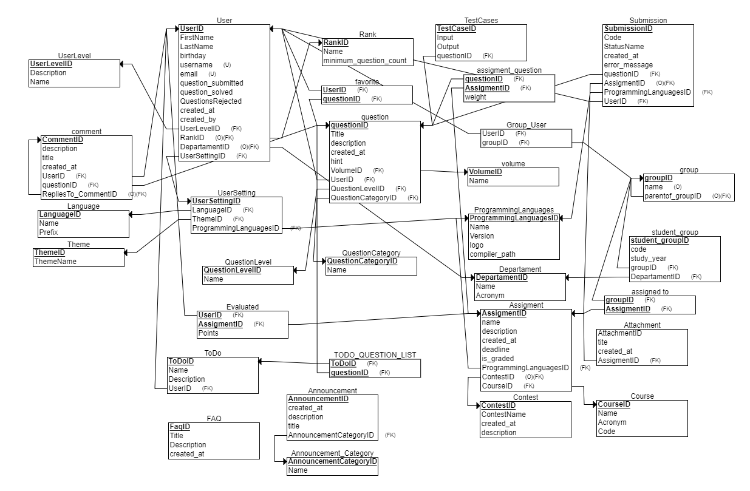
RS

Slide 14
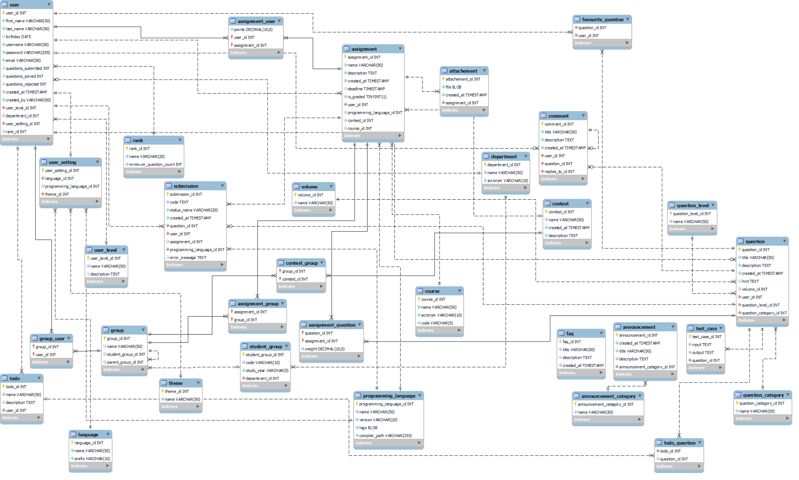
EERD

Slide 15
Database Creation
First we had to setup our environment. We installed MySQL and MySQL Workbench locally.
After we finished the ERD and RS in ERDPlus we generated the SQL code. We added some constraints and modified it, because it was incomplete.
After many changes we had a final version of the database ready.
Our database has 25 entities and 7 junction tables making a total of 32 tables.
To fill our database with information we took advantage of the IDE’s GUI which makes it easy to generate INSERT statements.

Slide 16
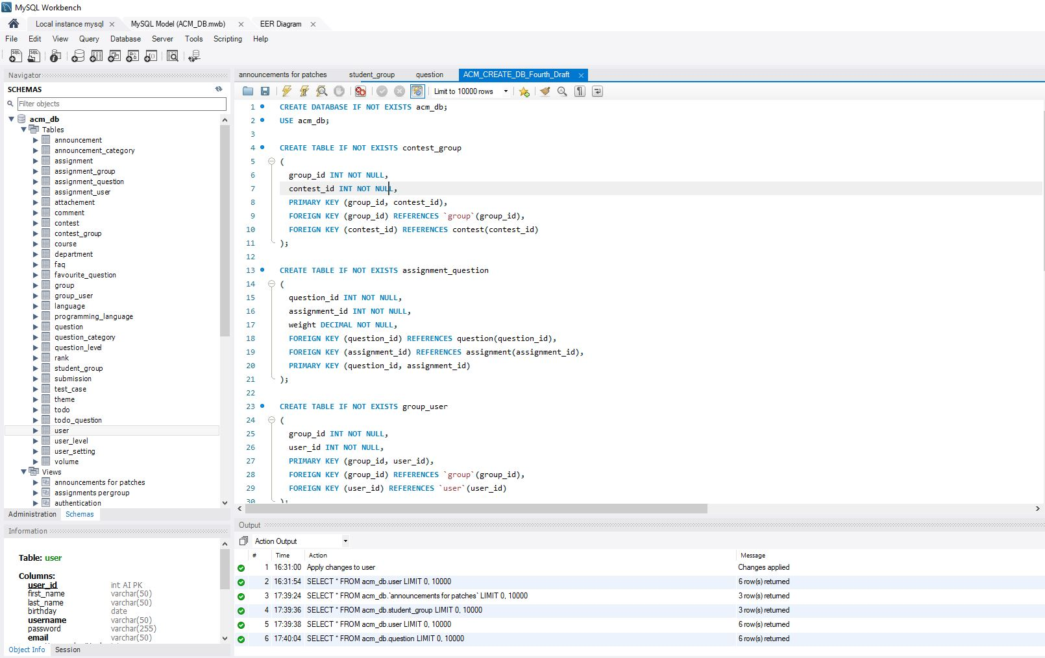

Slide 17
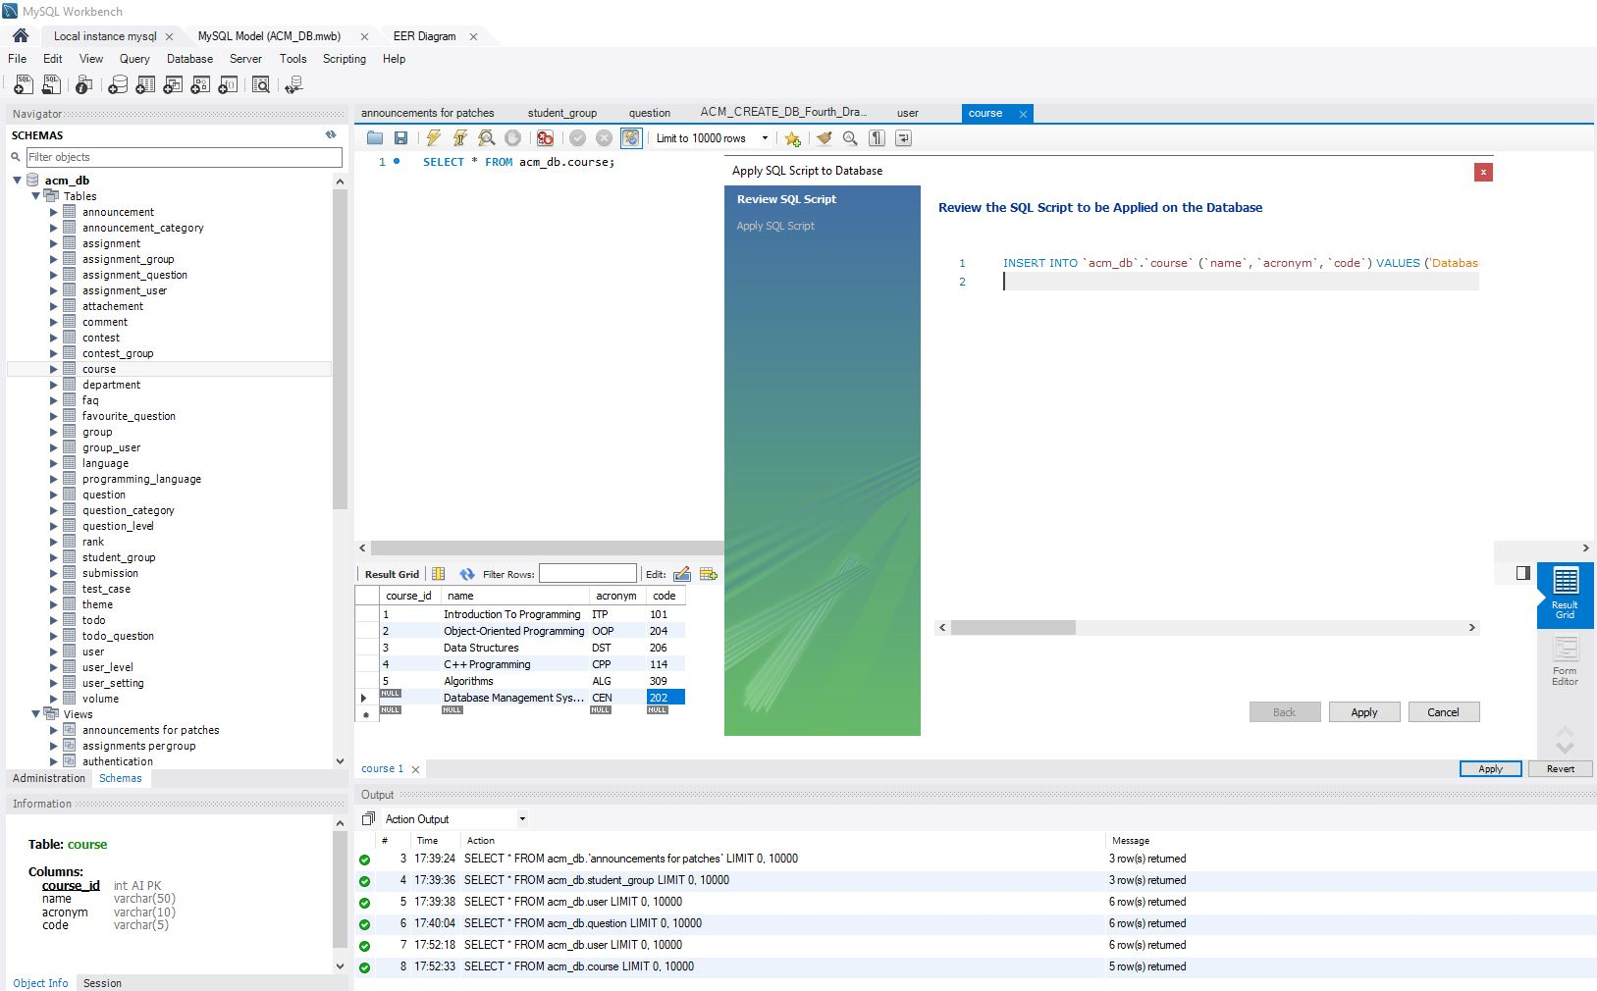

Slide 18
Managerial Queries

Slide 19
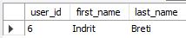
1 - Authenticate user from username and password
CREATE VIEW `Authentication` AS
SELECT user_id, `first_name`, `last_name`
FROM `user`
WHERE `password` = '$2a$12$D3sepOMfL5NAYBDA8Nfk1OS/4uxtYCTekD2JDJZ3gmEsNbbqSuRw.'
AND username = 'ibreti';
Notes:
Alda

Slide 20
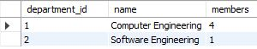
2 - Count users for every department
CREATE VIEW `Student count per Department` AS
SELECT `user`.department_id, `name`, COUNT(*) as members
FROM `user`, department
WHERE `user`.department_id = department.department_id
Notes:
Alda

Slide 21
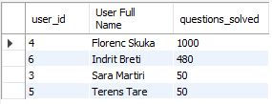
3 - Get the users with the most solved questions
CREATE VIEW `Top 10` AS
SELECT user_id,
CONCAT(first_name, " ", last_name) AS 'User Full Name',
questions_solved FROM `user`
WHERE questions_solved IS NOT NULL
ORDER BY questions_solved DESC, CONCAT(first_name, " ", last_name) ASC
LIMIT 10;
Notes:
Melisa

Slide 22
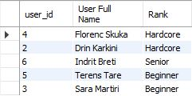
4 - Get all users and their ranks
CREATE VIEW `User and rank` AS
SELECT u.user_id,
CONCAT(u.first_name, ' ', u.last_name) AS 'User Full Name',
r.`name` AS 'Rank'
FROM `user` AS u
JOIN `rank` AS r
ON u.rank_id = r.rank_id
ORDER BY r.rank_id DESC, CONCAT(u.first_name, ' ', u.last_name) ASC;
Notes:
Melisa

Slide 23
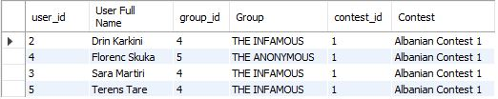
5 - Get all users, groups and contests
CREATE VIEW `Users groups and contests` AS
SELECT u.user_id,
CONCAT(u.first_name, ' ', u.last_name) AS `User Full Name`,
g.group_id, g.`name` AS 'Group',
c.contest_id, c.`name` AS 'Contest'
FROM `user` AS u
JOIN group_user AS g_u ON u.user_id = g_u.user_id
JOIN `group` as g ON g_u.group_id = g.group_id
JOIN contest_group AS c_g ON g.group_id = c_g.group_id
JOIN contest AS c ON c_g.contest_id = c.contest_id
ORDER BY CONCAT(u.first_name, ' ', u.last_name) ASC;
Notes:
Melisa

Slide 24
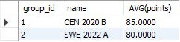
6 - Get all average points per group
CREATE VIEW `Average points per group` AS SELECT group_id, `name`, AVG(points)
FROM (
SELECT u.user_id, g.group_id, `name`
FROM group_user AS g_u
JOIN `user` AS u
ON g_u.user_id = u.user_id
JOIN `group` AS g
ON g.group_id = g_u.group_id
WHERE g.student_group_id IS NOT NULL
) AS g_u
JOIN assignment_user
ON assignment_user.user_id = g_u.user_id
GROUP BY g_u.group_id;
Notes:
Drin

Slide 25
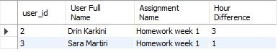
7 - Get all submissions submitted at most 24 hours after assignment creation
CREATE VIEW `Submissions 1 day before assignment creation` AS
SELECT u.user_id,
CONCAT(first_name, ' ', last_name) AS 'User Full Name',
`name` AS 'Assignment Name',
TIMESTAMPDIFF(HOUR, a.created_at, s.created_at) AS 'Hour Difference'
FROM `user` AS u
JOIN submission AS s
ON U.user_id = s.user_id
JOIN assignment AS a
ON s.assignment_id = a.assignment_id
WHERE TIMESTAMPDIFF(HOUR, a.created_at, s.created_at) < 24;
Notes:
Drin

Slide 26
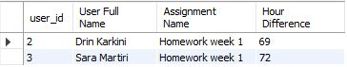
8 - Get all submissions submitted after the deadline
CREATE VIEW `Submissions after deadline` AS
SELECT u.user_id,
CONCAT(first_name, ' ', last_name) AS 'User Full Name',
`name` AS 'Assignment Name',
TIMESTAMPDIFF(HOUR, a.deadline, s.created_at) AS `Hour Difference`
FROM `user` AS u
JOIN submission AS s
ON u.user_id = s.user_id
JOIN assignment AS a
ON s.assignment_id = a.assignment_id
WHERE TIMESTAMPDIFF(HOUR, a.deadline, s.created_at) >= 0;
Notes:
Drin

Slide 27
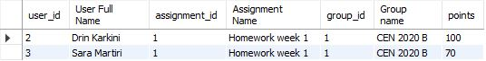
9 - Get all points for a group for an assignment
CREATE VIEW `Points for specific assignment and specific group` AS SELECT u.user_id, CONCAT(u.first_name, " ", u.last_name) AS 'User Full Name', a.assignment_id, a.`name` AS 'Assignment Name', g.group_id, g.`name` AS 'Group name', points FROM `user` AS u JOIN assignment_user AS a_u ON u.user_id = a_u.user_id JOIN assignment AS a
ON a_u.assignment_id = a.assignment_id JOIN group_user AS g_u ON u.user_id = g_u.user_id JOIN `group` AS g ON g_u.group_id = g.group_id WHERE g.group_id = ( SELECT group_id FROM `group` WHERE `name` = 'CEN 2020 B' ) AND a.assignment_id = ( SELECT assignment_id FROM assignment WHERE `name` = 'Homework week 1' );
Notes:
Drin

Slide 28
10 - Get all TODO-s with at least 5 questions
CREATE VIEW `To Do's with at least 5 questions` AS
SELECT t.todo_id, t.`name` AS 'TODO Name', t.`description` AS 'TODO Description',
u.user_id, CONCAT(u.first_name, ' ', u.last_name) AS 'User Full Name',
COUNT(q.question_id) AS 'Number of questions'
FROM todo_question AS t_q
JOIN todo as t ON t_q.todo_id = t.todo_id
JOIN question AS q ON t_q.question_id = q.question_id
JOIN `user` AS u ON t.user_id = u.user_id
GROUP BY t.todo_id
HAVING COUNT(q.question_id) >= 5;
Notes:
Drin

Slide 29
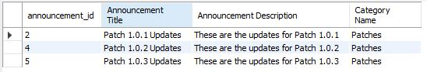
11 - Get all announcements from category 2 (patches).
CREATE VIEW `Announcements for Patches` AS
SELECT announcement_id,
title as 'Announcement Title',
`description` AS 'Announcement Description',
`name` AS 'Category Name'
FROM announcement AS an
JOIN announcement_category AS an_cat
ON an.announcement_category_id = an_cat.announcement_category_id
WHERE an.announcement_category_id = 2;
Notes:
Sara

Slide 30
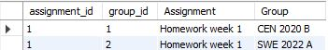
12 - Get all assignments per Group
CREATE VIEW `Assignments per Group` AS
SELECT assignment.assignment_id,
`group`.group_id,
assignment.`name` AS 'Assignment',
`group`.`name` AS 'Group'
FROM assignment_group, assignment, `group`
WHERE assignment_group.assignment_id = assignment.assignment_id
AND assignment_group.group_id = `group`.group_id;
Notes:
Sara

Slide 31
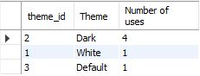
13 - Get the top 3 preferred themes
CREATE VIEW `Top 3 preferred themes` AS
SELECT t.theme_id,
t.`name` AS 'Theme',
COUNT(t.theme_id) AS 'Number of uses'
FROM `user` AS u
JOIN user_setting AS u_s
ON u.user_setting_id = u_s.user_setting_id
JOIN theme AS t
ON u_s.theme_id = t.theme_id
GROUP BY t.theme_id
ORDER BY COUNT(t.theme_id) DESC
LIMIT 3;
Notes:
Sara

Slide 32
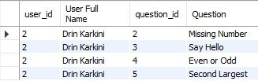
14 - Get favorite questions of a user.
CREATE VIEW `Favorite question of user` AS
SELECT u.user_id,
CONCAT(u.first_name, ' ', u.last_name) AS `User Full Name`,
q.question_id,
q.title AS `Question`
FROM `user` AS u
JOIN favourite_question as fav
ON u.user_id = fav.user_id
JOIN question as q
ON fav.question_id = q.question_id
WHERE u.user_id = 2
AND CONCAT(u.first_name, ' ', u.last_name) = 'Drin Karkini';
Notes:
Sara

Slide 33
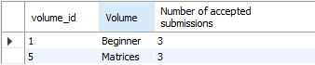
15 - Get top 5 solved volumes
CREATE VIEW `Top 5 solved volumes`AS
SELECT v.volume_id,
v.`name` AS 'Volume',
COUNT(DISTINCT q.question_id, s.status_name, s.user_id) AS 'Number of accepted submissions'
FROM submission AS s
JOIN question AS q ON s.question_id = q.question_id
JOIN volume AS v ON q.volume_id = v.volume_id
WHERE s.status_name = 'Accepted !'
GROUP BY v.volume_id
ORDER BY COUNT(DISTINCT q.question_id, s.status_name, s.user_id) DESC
LIMIT 5;
Notes:
Sara

Slide 34
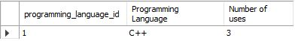
16 - Get the most preferred programming language.
CREATE VIEW `Most preferred programming language` AS
SELECT p.programming_language_id,
p.`name` AS 'Programming Language',
COUNT(p.programming_language_id) AS 'Number of uses'
FROM `user` AS u
JOIN user_setting AS u_s
ON u.user_setting_id = u_s.user_setting_id
JOIN programming_language AS p
ON u_s.programming_language_id = p.programming_language_id
GROUP BY p.programming_language_id
ORDER BY COUNT(p.programming_language_id) DESC LIMIT 1;
Notes:
Terens

Slide 35
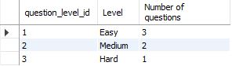
17 - Count questions for every question level
CREATE VIEW `Questions count per question level` AS
SELECT qlev.question_level_id,
qlev.`name` AS 'Level',
COUNT(q.question_id) AS 'Number of questions'
FROM question AS q
JOIN question_level AS qlev
ON q.question_level_id = qlev.question_level_id
GROUP BY qlev.question_level_id;
Notes:
Terens

Slide 36
18 - Get every question for every assignment
CREATE VIEW `Questions For Assignments` AS
SELECT question.question_id, `name` AS 'Assignment Name',
title AS 'Question',
assignment.`description` AS 'Assignment Description',
question.`description` AS 'Question Description'
FROM assignment, question, assignment_question
WHERE question.question_id = assignment_question.question_id
AND assignment.assignment_id = assignment_question.assignment_id;
Notes:
Terens

Slide 37
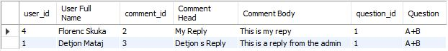
19 - Get all replies for a question
CREATE VIEW `Replies to comment` AS
SELECT u.user_id,
CONCAT(u.first_name, ' ', u.last_name) AS `User Full Name`,
c.comment_id,
c.title AS 'Comment Head',
c.`description` AS 'Comment Body',
q.question_id,
q.title AS 'Question'
FROM `comment` AS c
JOIN `user` AS u
ON c.user_id = u.user_id
JOIN question AS q
ON c.question_id = q.question_id
WHERE c.replies_to_id = 1;
Notes:
Terens

Slide 38
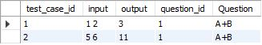
20 - Get all test cases for a question
CREATE VIEW `Test cases of question` AS
SELECT t_c.test_case_id,
t_c.input,
t_c.output,
q.question_id,
q.title AS 'Question'
FROM test_case AS t_c
JOIN question AS q
ON t_c.question_id = q.question_id
WHERE q.question_id = 1;
Notes:
Terens

Slide 39

Research and Idea Consolidation
The steps taken to fulfill our our project ideas.

Slide 40
Research
After converting ERD to RS we searched for methods to improve our database. First we saw different normalization methods for improving data consistency and reduce data redundancy.
We know that database it’s not standalone and the normalization and designing it's not the only factor that affect the efficiency of it. After some research we concluded the implementation of the database (DBMS softwares and paradigms) and the hardware plays an important role.
Design Improvements
The N + 1 Problem and Query speed
Why MySQL?
Advantages of MySql
Hardware issues
Improving MySQL by using another DBMS Paradigms
Redis? Why ? What ? How?
Security

Slide 41
Normalization
By normalizing our database up to 3NF (slightly to 3.5NF Boyce-Codd), we noticed the following benefits:
Elimination of redundant data: Repeated (redundant) entries were removed from the tables of the database, allowing for smaller amounts of data to be used.
Data consistency: Having removed redundant data, we replaced them with references (FK) to the needed tables. This allowed us to apply changes on a single table and reflect it on all tables depending on the changed information, thus making our database more consistent.
Better and quicker execution: We have reduced the number of columns per table and increased the number of tables on our database making it faster to execute queries.
Greater database organization: Having split our data into specific tables, we have provided a logical separation of attributes, thus making it easier for us to create a mental model for how the system works. This allows for an increased understanding of the system and ease of operation with it.

Slide 42
N + 1 Problem
The N + 1 problem is an anti-pattern that is a problem with ORMs in general, which most often occurs with lazy loading.
The N + 1 problem occurs when an application gets data from the database, and then loops through the result of that data.
That means we call to the database again and again and again.
In total, the application will call the database once for every row returned by the first query (N) plus the original query ( + 1).
All of those calls could have been accomplished in one simple join query call.
It may slightly optimizes it since joins may not be a good idea especially in poorly designed databases where may not perform well.

Slide 43


More Improvements
Why MySQL?
Query Speed Measurements
Combining with Redis
Data Security and Integrity

Slide 44
Why MySQL ?
On-Demand Scalability - MySQL offers unmatched scalability to facilitate the management of deeply embedded apps using a smaller footprint, even in massive warehouses that stack terabytes of data.
Round-the-Clock Uptime - MySQL comes with the assurance of 24×7 uptime and offers a wide range of high-availability solutions, including specialized cluster servers and master/slave replication configurations.
High Performance - A unique storage-engine architecture allows database professionals to configure the MySQL database server specifically for particular applications, with the end result being amazing performance results.
High Availability - Rock-solid reliability and constant availability are hallmarks of MySQL, with customers relying on MySQL to guarantee around-the-clock uptime.
Robust Transactional Support - MySQL offers one of the most powerful transactional database engines on the market.

Slide 45
Why MySQL ? (cont.)
Strong Data Protection - Because guarding the data assets of corporations is the number one job of database professionals, MySQL offers exceptional security features that ensure absolute data protection.
Comprehensive Application Development - It doesn't matter if it's PHP, Perl, Java, Visual Basic, or .NET, MySQL offers application developers everything they need to be successful in building database-driven information systems.
Management Ease - MySQL offers exceptional quick-start capability with the average time from software download to installation completion being less than fifteen minutes.
Open Source Freedom and 24 x 7 Support - MySQL is not a typical open source project as all the software is owned and supported by Oracle, and because of this, a unique cost and support model are available that provides a combination of open source freedom and trusted software with support.
Web and Data Warehouse Strengths - MySQL is the de-facto standard for high-traffic web sites because of its high-performance query engine, tremendously fast data insert capability, and strong support for specialized web functions like fast full text searches.

Slide 46
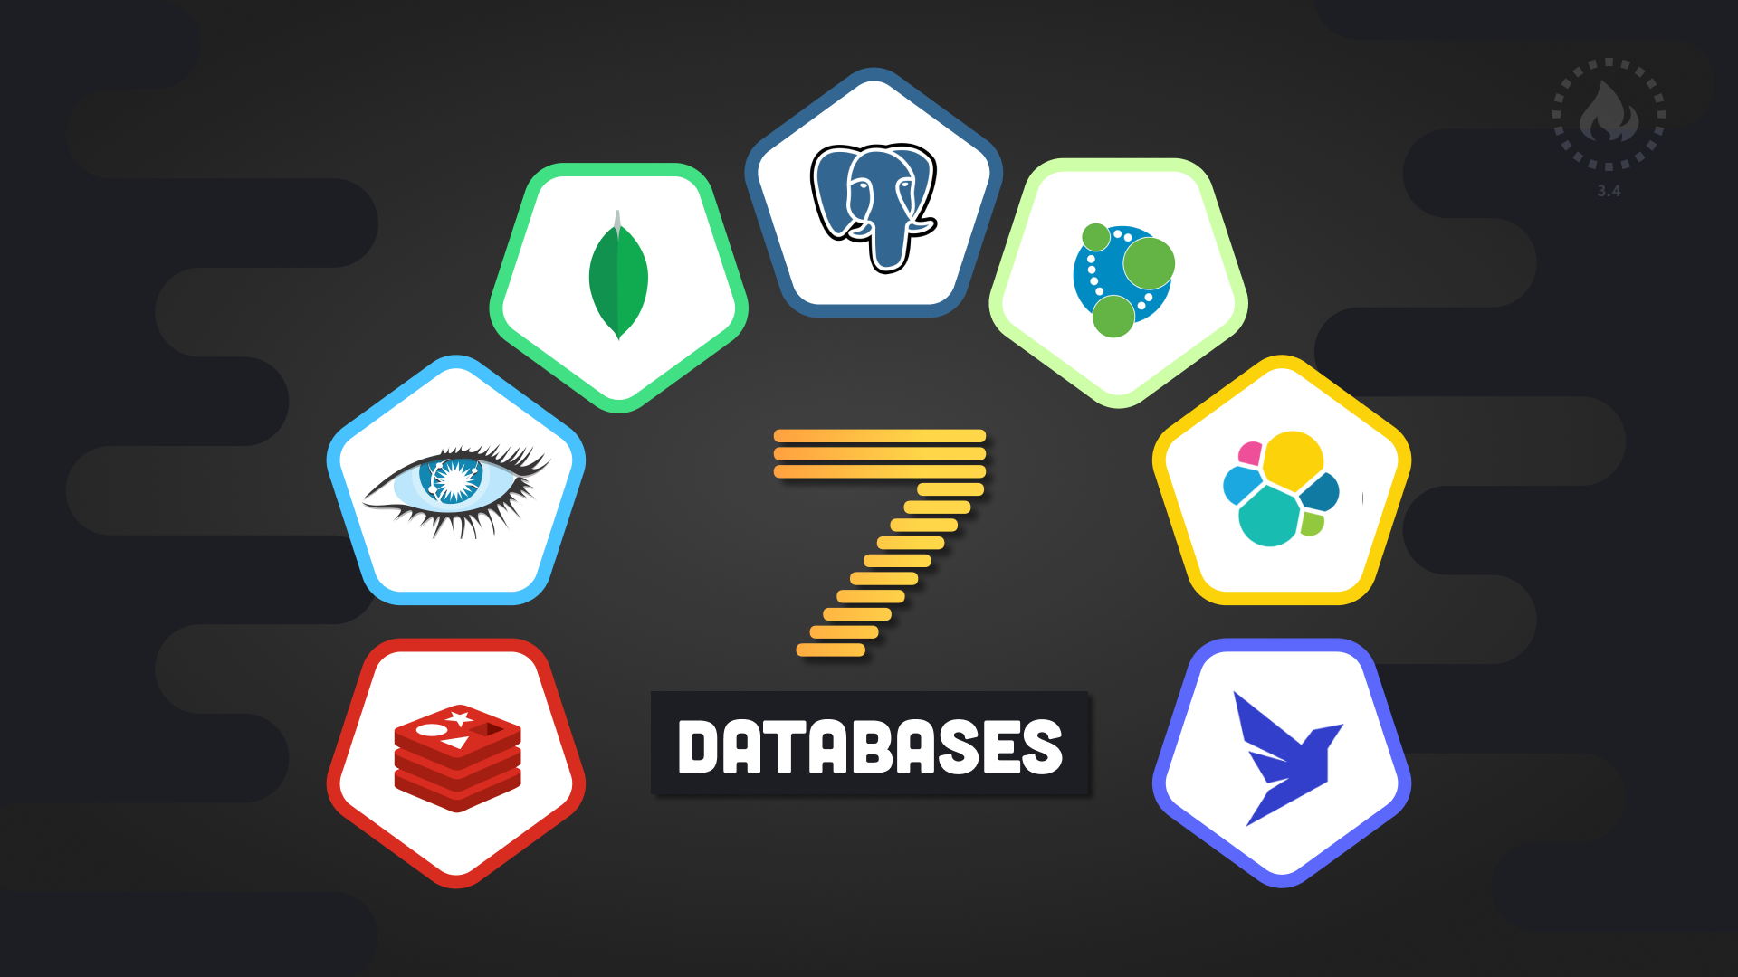
Improving MySQL by using other DBMS Paradigms

Slide 47
What is Redis?
Redis (Nosql) is an in-memory data structure store, used as a distributed, in-memory key–value database, cache and message broker, with optional durability.

Slide 48
Why Redis?
As mentioned above Redis is an in-memory database since it makes it good for caching.
One of the things that’s so great about Redis is how well it can complement and extend other databases in your ecosystem.
While replacing legacy backend databases with newer ones is often seen as expensive and risky, they don’t easily scale in the linear fashion required for users’ ‘instant experience’ expectations.
Some of the things that make it difficult to accommodate modern application needs using a traditional MySQL architecture are:
Read/write speeds of traditional databases are not good enough for use cases such as session stores.
Introducing new tables or modifying an existing schema can be extremely complex, which makes adding new features and applications extremely difficult.
Legacy databases are limited by the number of operations you can perform per second and by the number of concurrent connections you can have.
I recommend using Redis behind the data access layer as a ‘system of engagement’ to store the hot data users engage with, while designating your MySQL as the ‘system of record.’

Slide 49
Redis As ‘System Engagement’
Cache: This provides a tiered model for memory access, in which applications store common, repeatedly read objects in Redis.
Session Store: In all interactive apps, the server maintains a unique session for each active user. Rather than relying on MySQL-like relational databases to persist session data, a single cluster of Redis on decently sized servers with sufficient RAM can manage thousands, if not millions of sessions.
Real-time Analytics: Gamification through leaderboards, dashboards, polls, messages, counters and other real-time aggregators require constant processing and communication with end-users. Redis’ powerful and highly efficient data structures enable you to collect, process and dissipate millions of simultaneous activities or objects to thousands of active users in real time.
Metering: Redis can also help developers cost-effectively manage the load on legacy servers during peak usage times by rate limiting the number of calls applications make every few seconds.

Slide 50
Query Speed Measurements
It took 0.535555 seconds to create the database and the tables.
Below are provided the measurements for the managerial queries:
0.016 seconds
< 0.001 seconds
< 0.001 seconds
0.016 seconds
0.016 seconds
0.016 seconds
< 0.001 seconds
0.016 seconds
0.016 seconds
< 0.001 seconds

Slide 51
Query Speed Measurements (cont.)
< 0.001 seconds
0.015 seconds
0.015 seconds
< 0.001 seconds
< 0.001 seconds
0.015 seconds
0.014 seconds
0.015 seconds
0.016 seconds
< 0.001 seconds
The speed of the queries are measured using MySQL Workbench. As we can see the queries executed very fast. These results are not affected only by the design of sql statements or database design. Depending on the hardware and the amount of data you may get different results.

Slide 52

Data Security and Integrity

Slide 53
Data Security
Data security refers to the prevention of data from unauthorized users.
It is only allowed to access the data to the authorized users.
In database, the DBA or head of department can access all the data.
Some users are only allowed to retrieve data, whereas others are allowed to retrieve as well as to modify the data.
Some Database Security Issues and their Causes
Insider threats
Human error
Exploitation of database software vulnerabilities
Buffer overflow exploitations
Backups Attacks
Denial of service (DoS/DDoS) attacks

Slide 54
Data Integrity
Data integrity is defined as the data contained in the database is both correct and consistent.
For this purpose, the data stored in the database must satisfy certain types of procedures (rules). The data in a database must be correct and consistent.
DBMS provides different ways to implement such types of constraints (rules). It can be implemented by rules i.e., Primary Key, Secondary Key, Foreign key.
Logical Integrity for Databases:
Entity Integrity
Referential Integrity
Domain Integrity
User-Defined Integrity
Physical Integrity
Protecting data against external factors, such as natural calamities, power outages, or hackers, falls under the domain of physical integrity.
Moreover, human faults, storage attrition, and several other problems can make data operators unable to obtain information from a database.

Slide 55

The End
Questions?

